Slide 1

R.M.K COLLEGE OF ENGINEERING AND TECHNOLOGY
A PROJECT ON
NEWS TRACKER APPLICATION
DONE BY:
Vishal G - 111619104169 (Team Leader)
Sivaram V - 111619104140
Sugathithyan M - 111619104147
Vignesh S - 111619104167

Slide 2

CONTENTS:
Abstract
Problem Statement
Proposed solution
Features
Technical Architecture
Tech Stack
Final deliverables
Advantages & Disadvantages
Future scope

Slide 3
ABSTRACT
As news is increasingly accessed on smartphones and tablets, the need for personalizing news app interactions is apparent. We report a series of three studies addressing key issues in the development of adaptive news app interfaces. We first surveyed users’ news reading preferences and behaviors; analysis revealed three primary types of reader. We then implemented and deployed an Android news app that logs users’ interactions with the app.We used the logs to train a classifier and showed that it is able to reliably recognize a user according to their reader type. Finally, we evaluated alternative, adaptive user interfaces for each reader type. The evaluation demonstrates the differential benefit of the adaptation for different users of the news app and the feasibility of adaptive interfaces for news apps.

Slide 4

PROBLEM STATEMENT
User are not getting relevant news ,user time is not saved and they can’t able to manage their schedule in their daily life.
In other existing application users need to face issues like they haven’t getting proper news ,subscribe to get news and getting unnecessary advertisement exist in the application.
The user is not able to identify the valuable news or valuable news application to manage their schedule.

Slide 5
PROPOSED SOLUTION
1)Idea / Solution description:
In context of changing the conventional reading method. We will aware of knowing the interested and uninterested topics of the user through which user will get relevant content what they need. By providing the news feed feature which contain quick short news where user time is saved.
2)Novelty / Uniqueness:
Implementing unique features like no ads. Knowing uninterested topics which makes our customer useful in their daily life.
3).Social Impact / Customer Satisfaction:
Since we provide short and crisp news user time is saved. User using the app regularly will create awareness of their surrounding.
4) Scalability:
We are using IBM Cloud so, website storage will automatically scale up and scale down. Designing the app by using feasible Tech Stack.

Slide 6
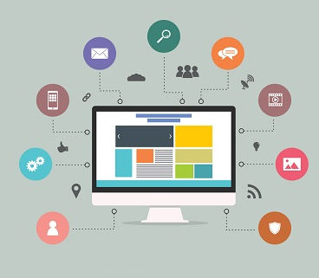
FEATURES:
In our application contains more features here some like,
No unnecessary ads.
Knowing uninterested topic or content.
Save as bookmarks.
Personalization according to the choice.
Latest news as notifications.
My feeds

Slide 7
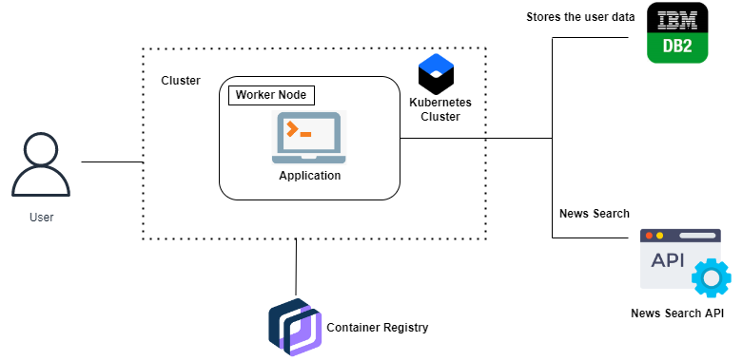
TECHNOLOGY ARCHITECTURE

Slide 8
TECH STACK:
HTML / CSS,
JavaScript,
JSON(JWT),
Python (Flask),
Rapid API (Newscatcher , Cricbuzz API),
Sendgrid,
IBM Cloud,
IBM DB2,
IBM Cloud Registry,
Kubernetes,
Docker.

Slide 9
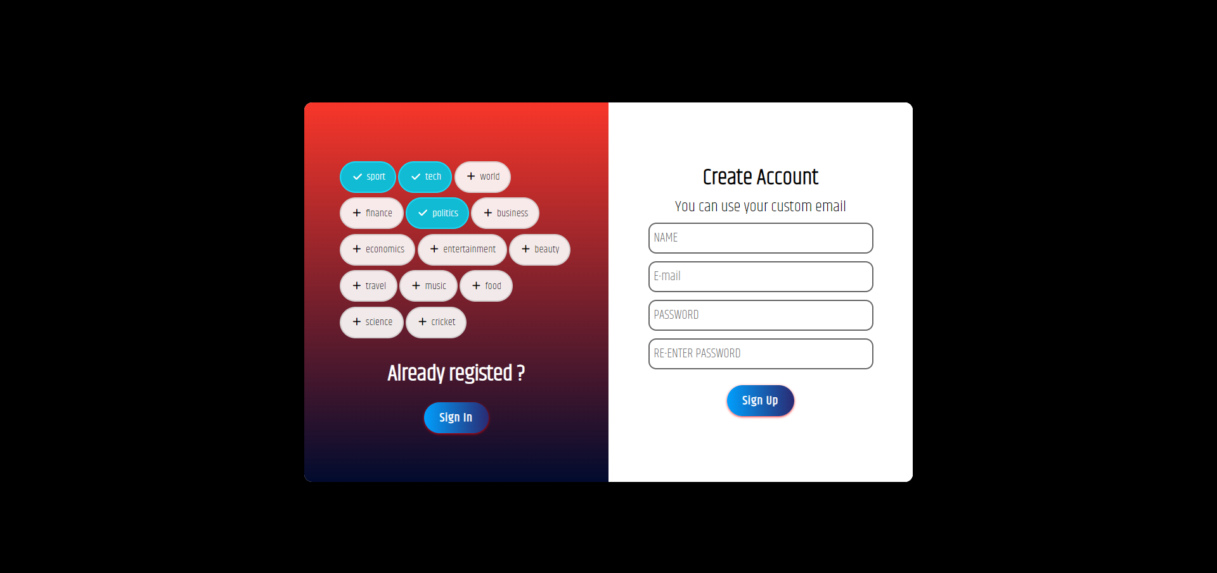
SIGN UP PAGE:

Slide 10
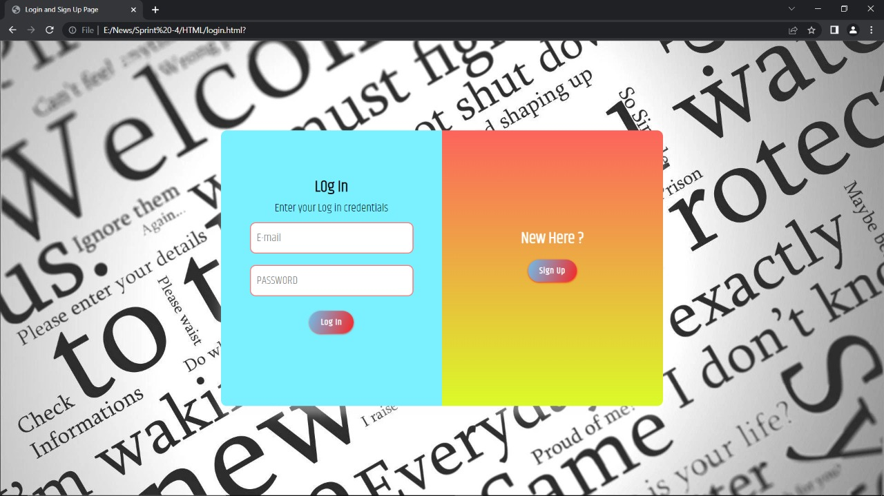
LOGIN PAGE:

Slide 11
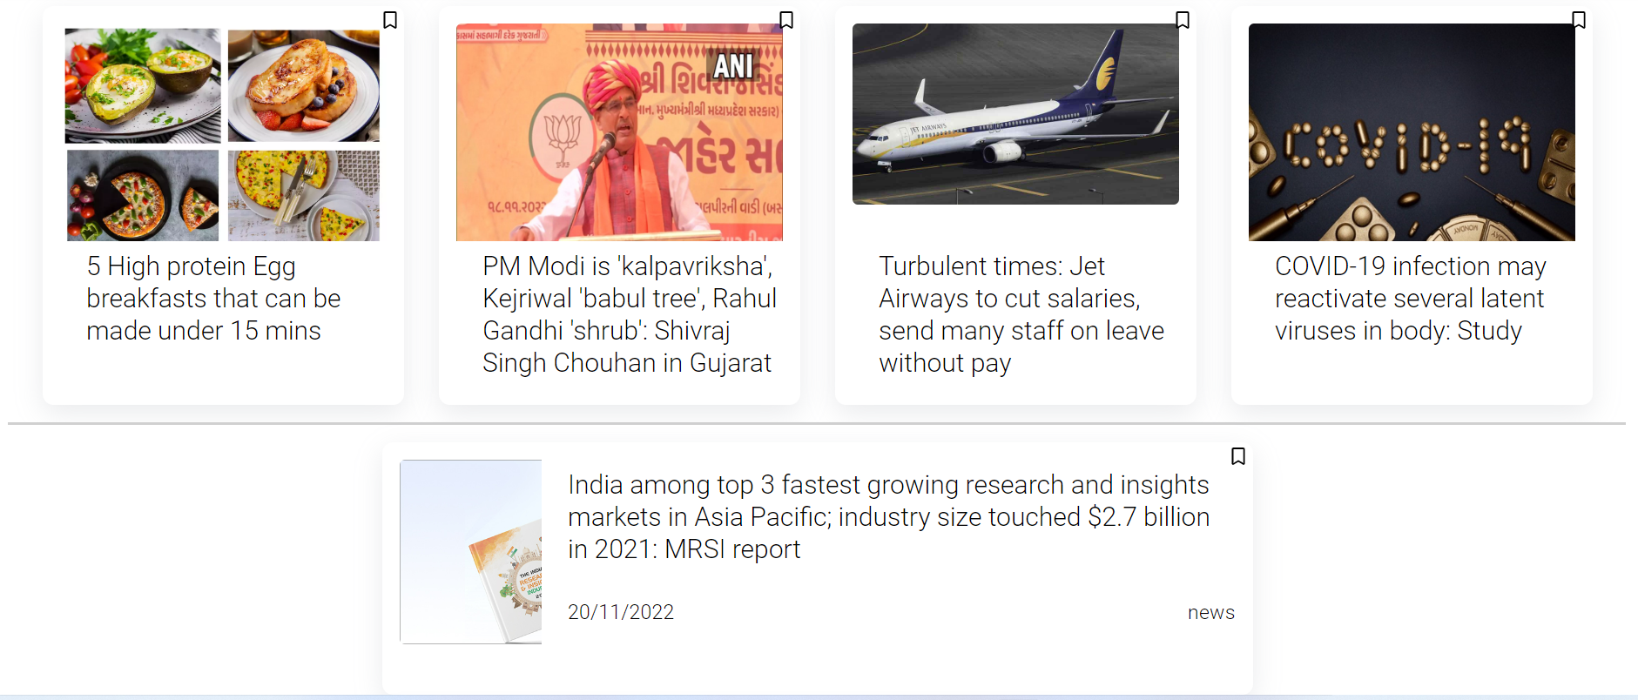
DASHBOARD:

Slide 12
ADVANTAGES:
DISADVANTAGES:
Used anywhere and anytime.
Security(JWT).
No Ads.
Easier, Simpler, Requires less time, resources and capacity.
Bookmarks.
News is only based on API.
Internet and power connectivity dependents.

Slide 13
FUTURE SCOPE:
Since it is a news web application we are planning to implement our application with more feature and better version of UI.
And we may integrate our own news API instead of third party API and may develop a mobile native application which will be used by both android and ios users.

Slide 14
THANK YOU

